Slide 1


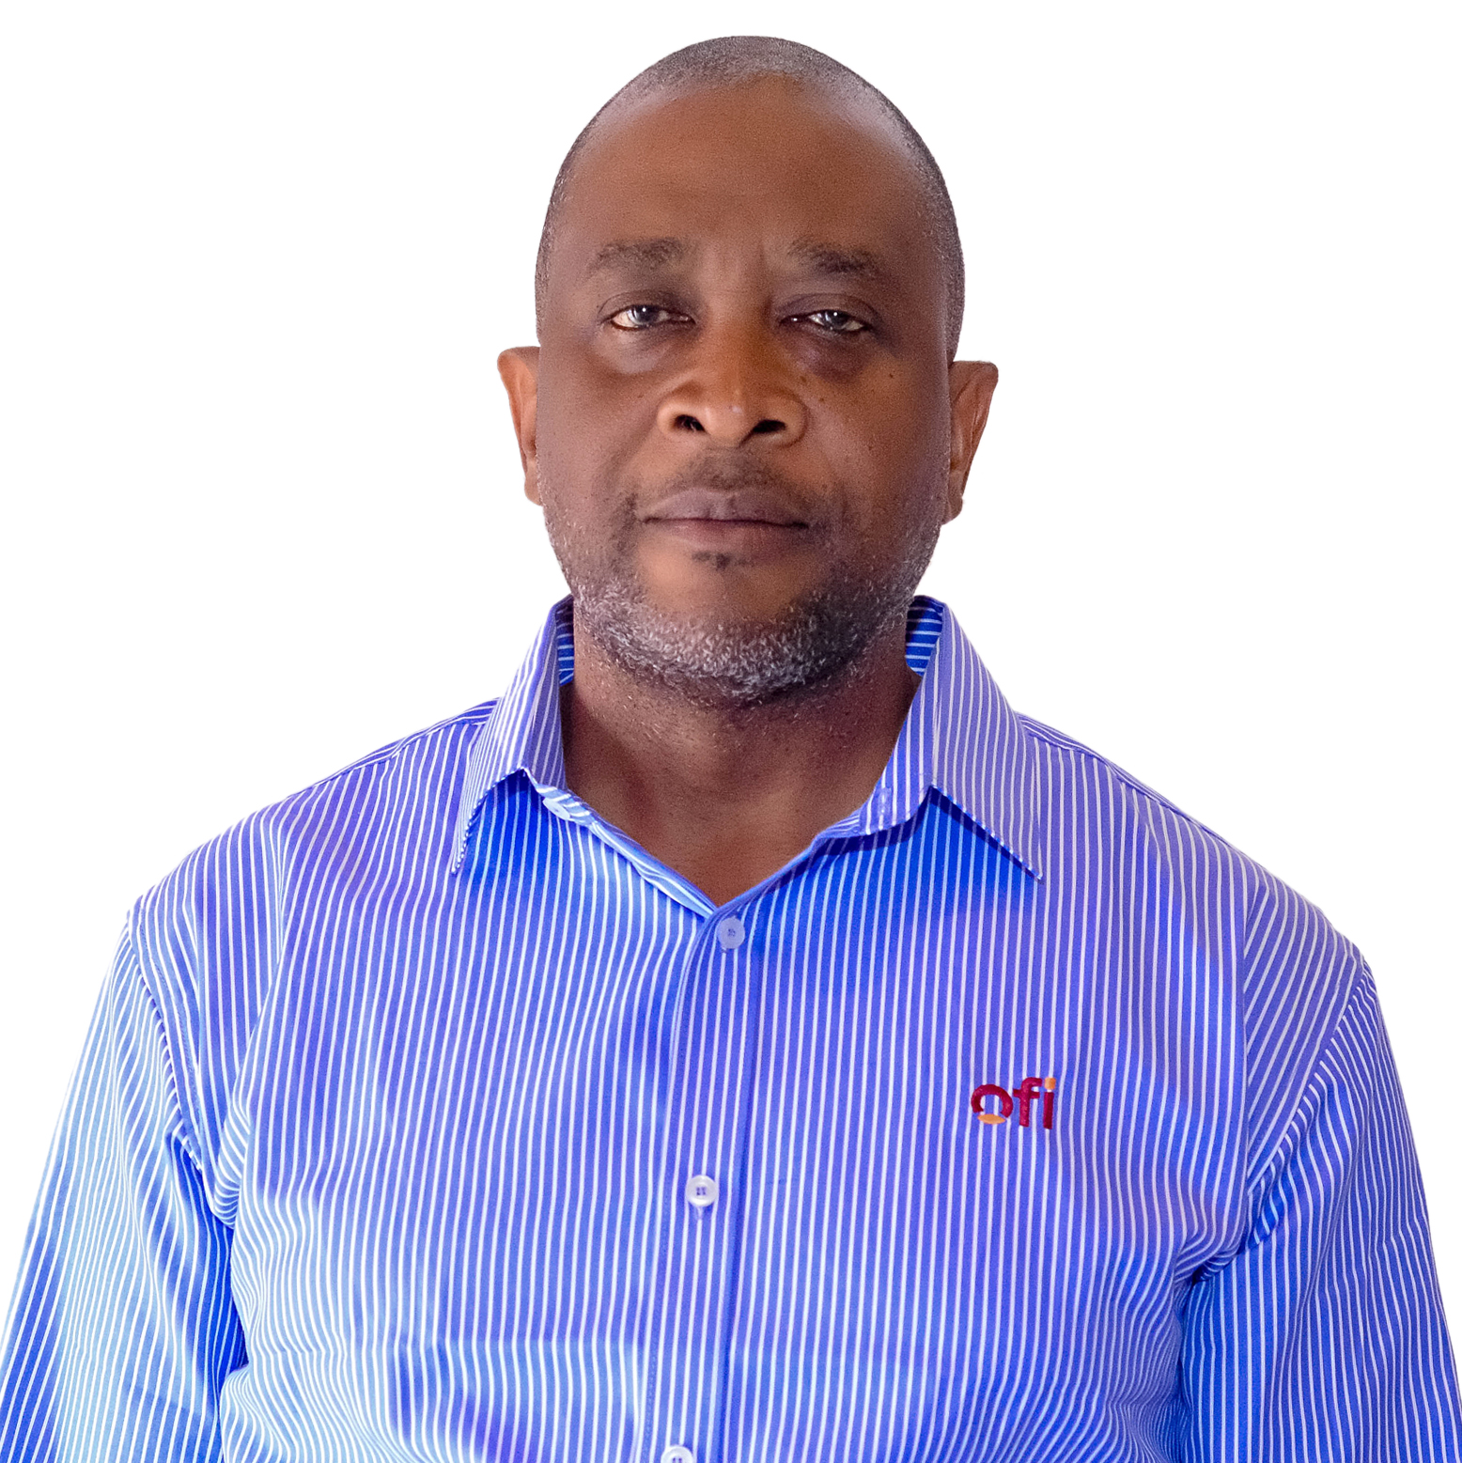
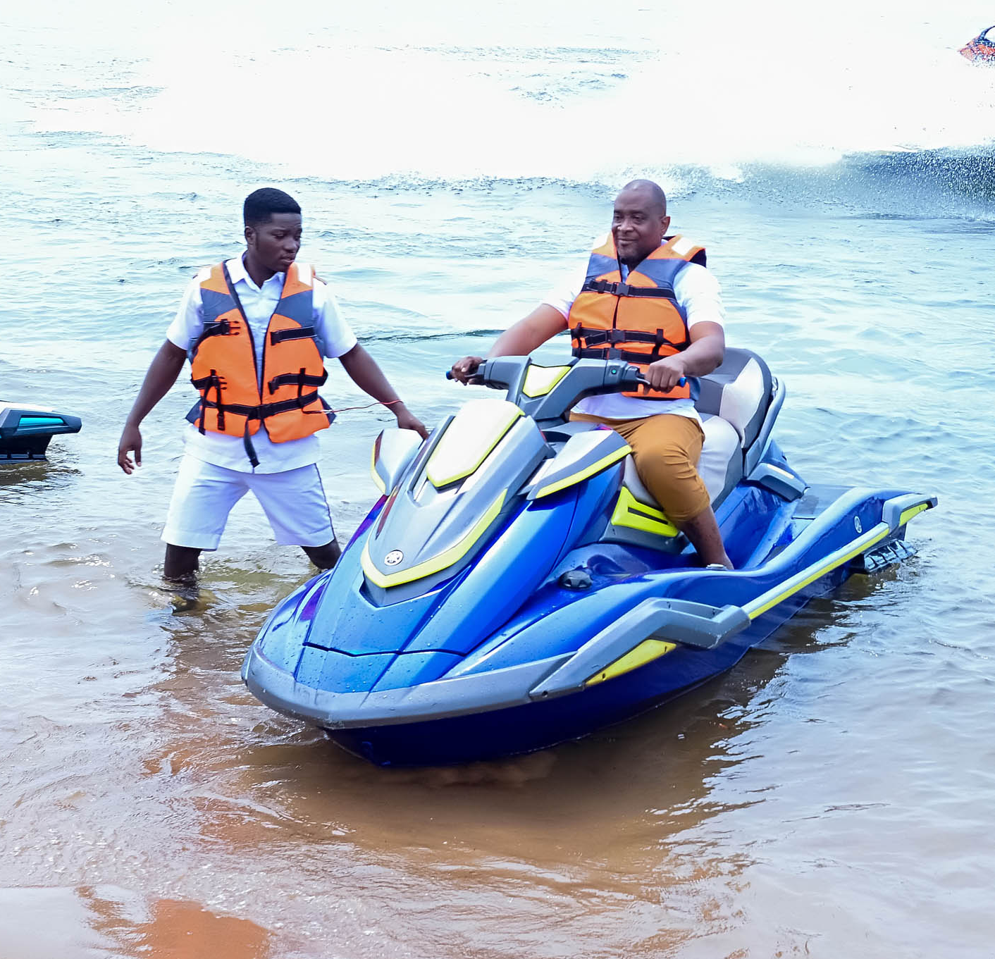
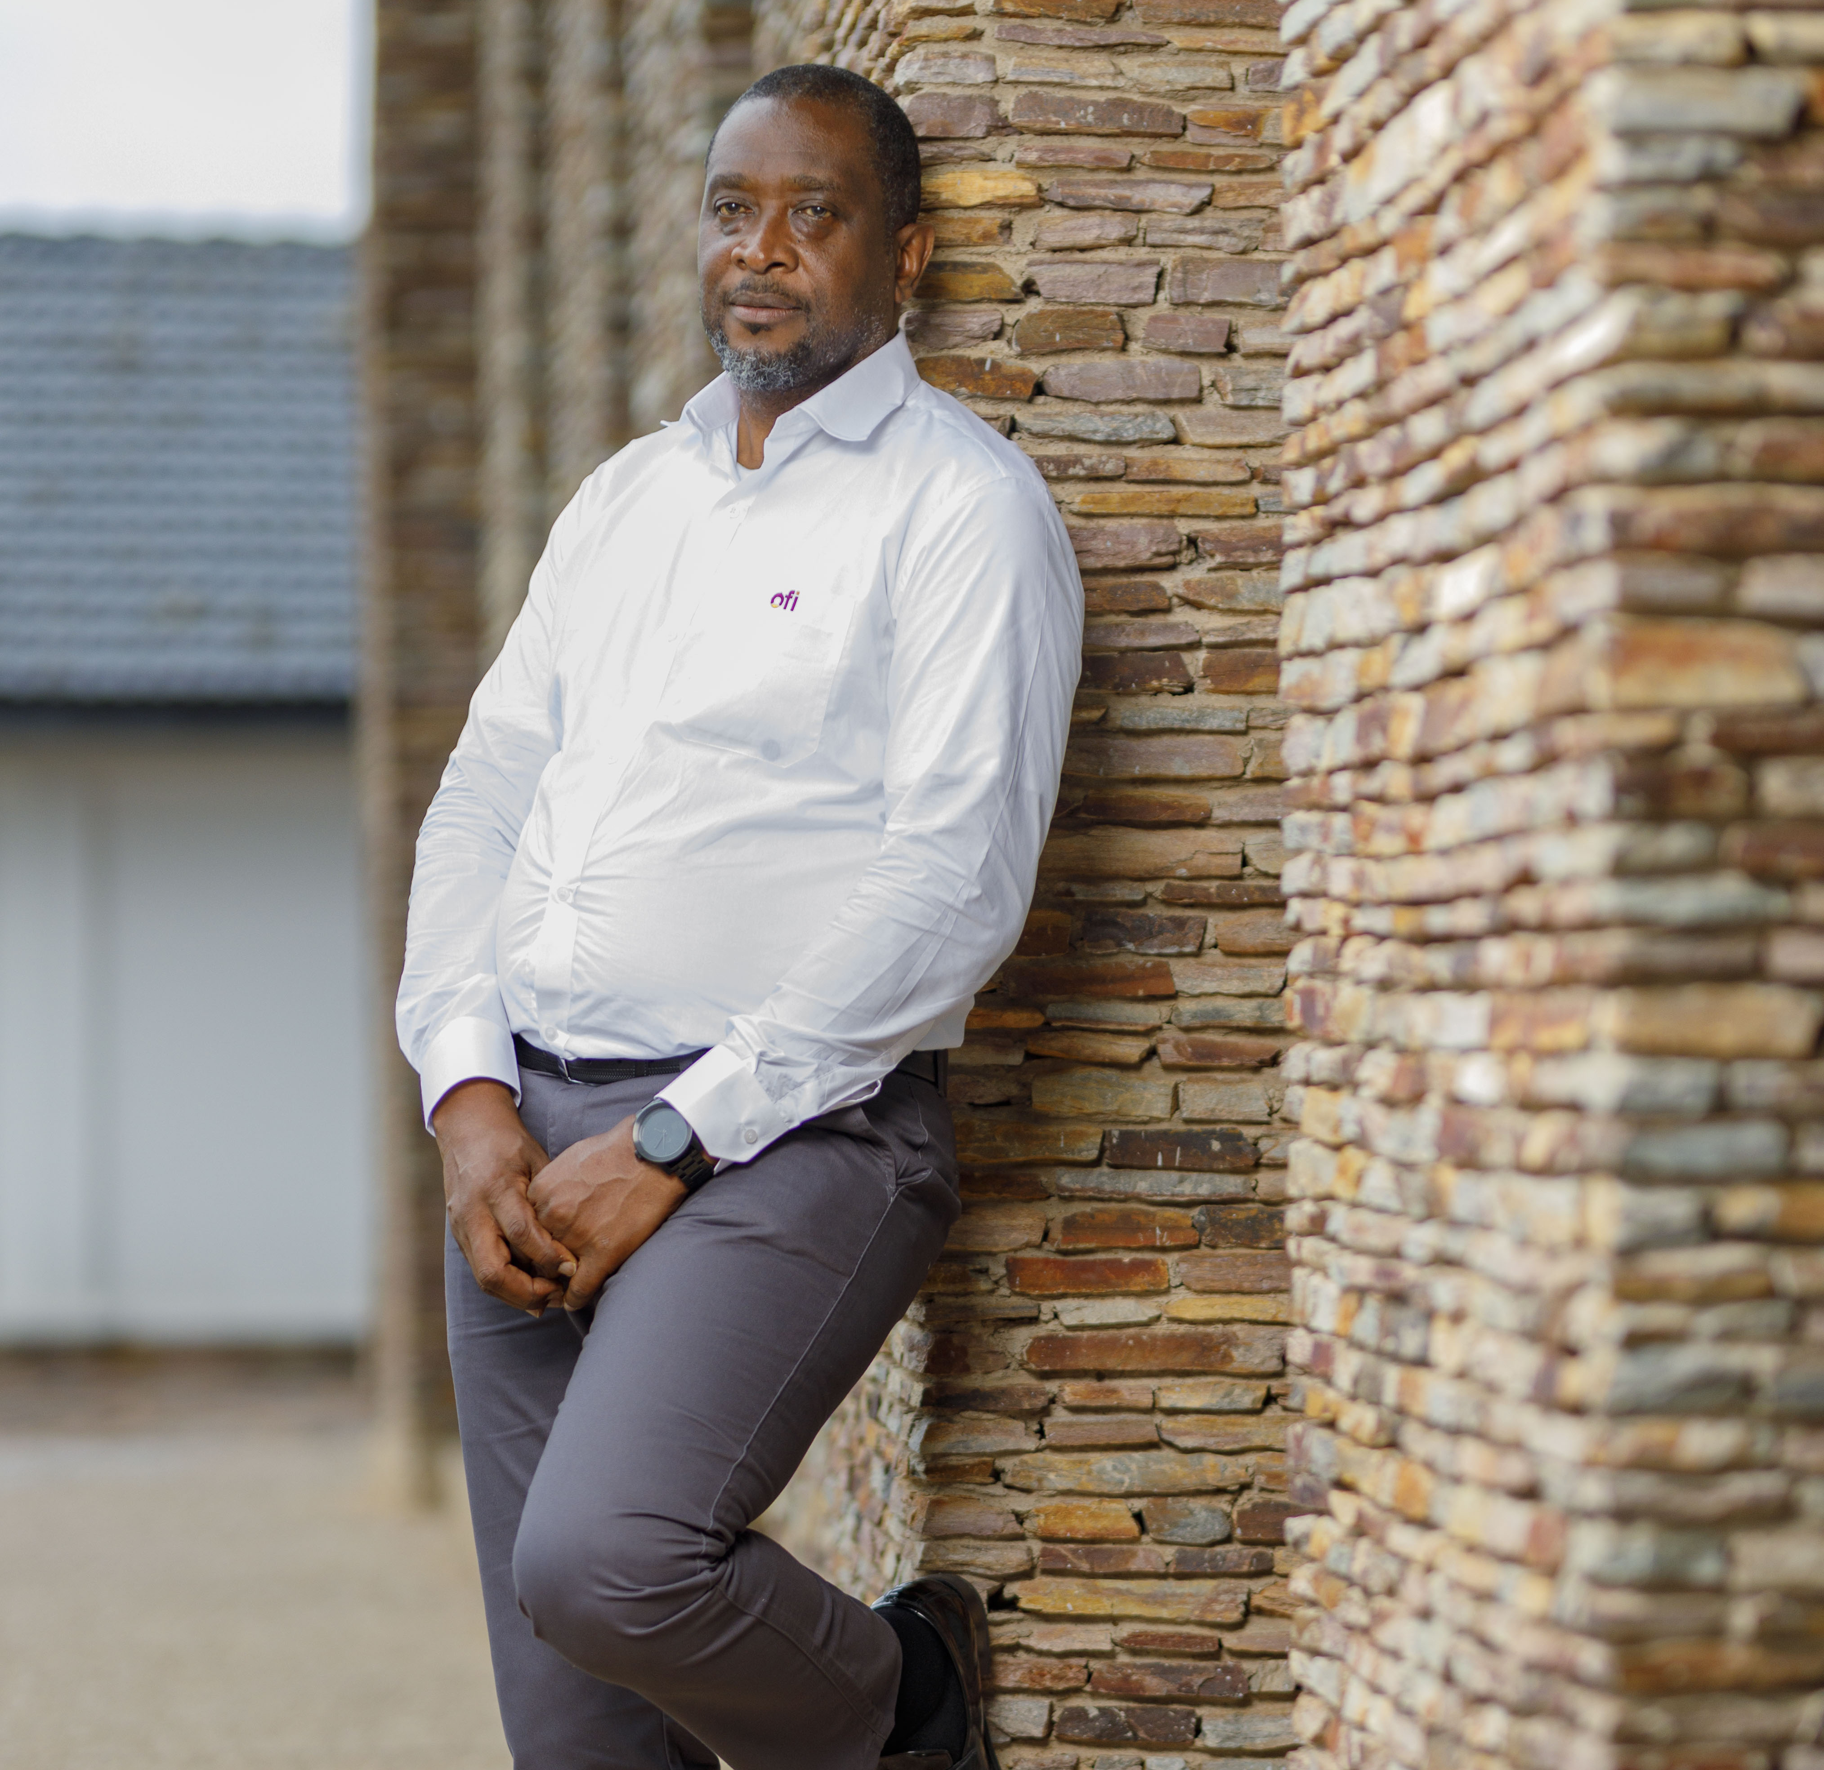
Getting to Know Me
Work
Personal
My role
Procurement Head of the Beans Business
Significant others / family members / furry friends in my life
Mother and Wife
Tenure in ofi/Olam
23 years
How I enjoy spending my free time
Hiking, listening to music, watching football
Previous companies I have worked at
Cashpro
My favorite / comfort food
Any deliciously cooked meal goes for me
Why I joined ofi/Olam and what keeps me here?
My previous company wound up! What keeps me here is that I enjoy the challenges of the cocoa industry
My favorite song
Any good music especially jazz, reggae and local music
Jonathan Quaynor
‘Patella’
A few fun facts about me
I love traveling and hiking. I am a big fan of adventure movies. I love taking on new challenges.
This is me outside work, doing stuff I enjoy in my life …

